Slide 1
“Durable Functions”
Enable long running Function Orchestrations

Slide 2
Why do we need “Durable Functions”
Enable “long running” functions while maintaining local state.
Simplify complex Function coordination (chaining, etc.)
Easily call a Function from another Function
All of the above using code-only

Slide 3
What is Durable Functions?
Advanced feature for writing long-running orchestrations as a single C# function. No JSON schemas. No designer.
New orchestrator functions can synchronously or asynchronously call other functions.
Automatic checkpointing, enabling “long running” functions.
Solves a variety of complex, transactional coding problems in serverless apps.
Built on the open source Durable Task Framework.
Notes:
https://github.com/Azure/durabletask

Slide 4

Pattern #1: Function chaining - Today
F1
F2
F3
F4
Problems:
No visualization to show relationship between functions and queues.
Middle queues are an implementation detail – conceptual overhead.
Error handling adds a lot more complexity.

Slide 5
Pattern #1: Function chaining - Better
// calls functions in sequence
public static async Task<object> Run(DurableOrchestrationContext ctx)
{
try
{
var x = await ctx.CallFunctionAsync("F1");
var y = await ctx.CallFunctionAsync("F2", x);
var z = await ctx.CallFunctionAsync("F3", y);
return await ctx.CallFunctionAsync("F4", z);
}
catch (Exception)
{
// global error handling/compensation goes here
}
}
Notes:
CallFunctionAsync uses queues under the covers, thus they can be scaled out to multiple VMs.

Slide 6
Pattern #2: Fan-out/Fan-in none durable design
F1
F3
F2
Problems:
Fanning-out is easy, but fanning-in is significantly more complicated
Functions offers no help with this scenario today
All the same problems of the previous pattern

Slide 7
Pattern #2: Fan-out/Fan-in - Easy
public static async Task Run(DurableOrchestrationContext ctx)
{
var parallelTasks = new List<Task<int>>();
// get a list of N work items to process in parallel
object[] workBatch = await ctx.CallFunctionAsync<object[]>("F1");
for (int i = 0; i < workBatch.Length; i++)
{
Task<int> task = ctx.CallFunctionAsync<int>("F2", workBatch[i]);
parallelTasks.Add(task);
}
await Task.WhenAll(parallelTasks);
// aggregate all N outputs and send result to F3
int sum = parallelTasks.Sum(t => t.Result);
await ctx.CallFunctionAsync("F3", sum);
}

Slide 8
Pattern #3: HTTP Async Response none durable design
Start
DoWork
GetStatus
Problems:
Execution state needs to be explicitly stored and managed.
Execution state and trigger state must be kept in sync manually.
Start and GetStatus is often boilerplate code that is not related to the business problem.

Slide 9
Pattern #3: HTTP Async Response – Built in!
> curl -X POST https://myfunc.azurewebsites.net/orchestrators/DoWork -H "Content-Length: 0" -i
HTTP/1.1 202 Accepted Location: https://myfunc.azurewebsites.net/orchestrators/b79baf67f717453ca9e86c5da21e03ec Server: Microsoft-IIS/8.0
> curl https://myfunc.azurewebsites.net/orchestrators/b79baf67f717453ca9e86c5da21e03ec -i
HTTP/1.1 202 Accepted Content-Length: 173 Content-Type: application/json Location: https://myfunc.azurewebsites.net/orchestrators/b79baf67f717453ca9e86c5da21e03ec Server: Microsoft-IIS/8.0
{"runtimeStatus":"Running","createdTime":"2017-03-16T21:20:36Z","lastUpdatedTime":"2017-03-16T21:20:47Z"}
> curl https://myfunc.azurewebsites.net/orchestrators/b79baf67f717453ca9e86c5da21e03ec -i
HTTP/1.1 200 OK Content-Length: 175 Content-Type: application/json Server: Microsoft-IIS/8.0
{"runtimeStatus":"Completed","createdTime":"2017-03-16T21:20:36Z","lastUpdatedTime":"2017-03-16T21:20:57Z"}
Notes:
Logic Apps and Microsoft Flow have built-in support for this pattern.
Note that specifics URL routes are subject to change (and have already changed since this deck was originally written).

Slide 10

Pattern #4: Actors
Problems:
Functions are stateless and short-lived.
Read/write access to external state needs to be carefully synchronized.
Functions do not support the singleton pattern today.

Slide 11
Pattern #4: Actors (Eternal Orchestrations)
public static async Task Run(DurableOrchestrationContext ctx)
{
int counterState = ctx.GetInput<int>();
string operation = await ctx.WaitForExternalEvent<string>("operation");
if (operation == "incr")
{
counterState++;
}
else if (operation == "decr")
{
counterState--;
}
ctx.ContinueAsNew(counterState);
}
Notes:
Note that orchestrators are single-threaded, so there is no need to worry about concurrency. Orchestration instances are also implicitly singletons, so they only run on one VM at a time.

Slide 12

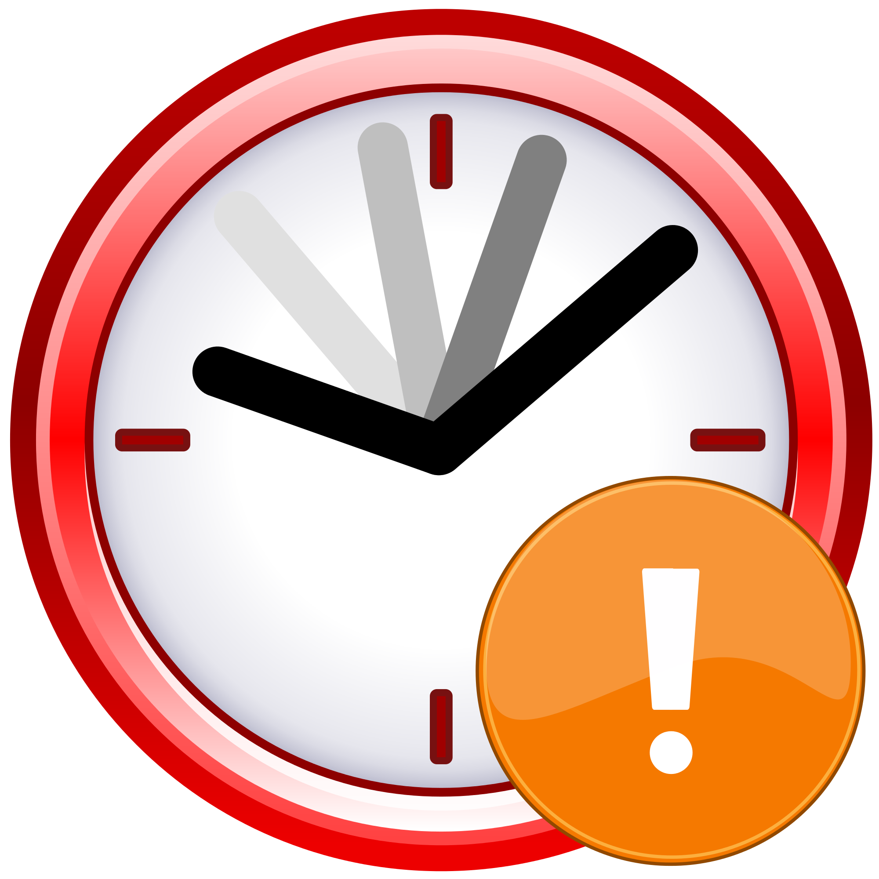
Pattern #5: Human Interaction w/Timeout
ProcessApproval
RequestApproval
Escalate
Problems:
Can’t easily coordinate a timeout with an approval request notification.
Need a mechanism to reliably cancel either the approval handling or the timeout depending on the outcome.

Slide 13
Pattern #5: Human Interaction w/Timeout
public static async Task Run(DurableOrchestrationContext ctx)
{
await ctx.CallFunctionAsync<object[]>("RequestApproval");
using (var timeoutCts = new CancellationTokenSource())
{
DateTime dueTime = ctx.CurrentUtcDateTime.AddHours(72);
Task durableTimeout = ctx.CreateTimer(dueTime, 0, cts.Token);
Task<bool> approvalEvent = ctx.WaitForExternalEvent<bool>("ApprovalEvent");
if (approvalEvent == await Task.WhenAny(approvalEvent, durableTimeout))
{
timeoutCts.Cancel();
await ctx.CallFunctionAsync("HandleApproval", approvalEvent.Result);
}
else
{
await ctx.CallFunctionAsync("Escalate");
}
}
}
Notes:
We will expose a mechanism for sending named events to an orchestrator from outside the orchestration context – e.g. REST API and/or output binding.

Slide 14
Important Orchestrator Limitations
Orchestrator code is replayed on every rehydration to restore all local state (local variables, etc).
Function calls are never replayed – the outputs are remembered.
This requires the orchestrator code to be deterministic.
Rule #1: Never write logic that depends on random numbers, DateTime.Now, Guid.NewGuid(), etc.
Rule #2: Never do I/O directly in the orchestrator function.
Rule #3: Do not write infinite loops
Rule #4: Use the built-in workarounds for rules #1, #2, and #3

Slide 15
Managing Instances
Azure Functions Core Tools:
https://learn.microsoft.com/en-us/azure/azure-functions/functions-run-local?tabs=v4%2Cwindows%2Ccsharp%2Cportal%2Cbash
func durable –help
func durable get-instances
func durable get-runtime-status --id f4302c36a47c42a59459de14e1d16297
func durable get-history --id f4302c36a47c42a59459de14e1d16297
func durable terminate --id f4302c36a47c42a59459de14e1d16297
https://learn.microsoft.com/en-us/azure/azure-functions/durable/durable-functions-instance-management?tabs=csharp

Slide 16
INTERNAL Design

Slide 17
Bindings
Trigger Bindings
Orchestration Trigger Binding
Triggers orchestrator functions
Polls control-queue
Partition-aware
Handles return values
Activity Trigger Binding
Triggers activity functions
Polls work-item queue
Stateless
Handles return values
Non-Trigger Bindings
Orchestrator Client
Output binding
Start new orchestrator instances
Terminate instances
Send event notifications
Fetch instance status*
Notes:
*Fetching instance status feels odd for an output binding. We may need a separate input binding for this.

Slide 18
Language Support
Activity functions and orchestrator client functions can be any supported language
Orchestrator functions are C#-only for now (until we finalize our long-term cross language support story)
Promises/Futures would be the Task equivalent primitives for other languages like node.js/Java/Go.

Slide 19

Storage Backend & Scale
Worker
Worker
Control Queue(s)
Worker
Work Item Queue
Triggers orchestrator
function execution
Triggers activity function execution
Worker
Worker
Stateful/Partitioned
History & Instance Tables
Stateless
Notes:
Detailed design is pending.

Slide 20
Key Takeaways
Orchestrator functions are:
Code: code-oriented way to implement business logic.
Stateful: local variables and execution progress is preserved.
Durable: no state is lost when the process recycles or the VM reboots.
Long-running: they can theoretically run forever:
Can go to sleep (dehydrate) and billing can be stopped while waiting for results.
Automatically wake up (hydrate) when there is more work to do.
Scalable: queue-based messaging allows for massive scale-out.

Slide 21
Functions and Logic Apps
Functions and Logic Apps work great together and that integration will only get better.
You can orchestrate Functions using Logic Apps today.
Durable Functions overlaps with Logic Apps, one function calling another, but:
Offers advance ‘code only’ orchestration ‘like’ capabilities to function
Enables "long running" functions
Enables "advance" scenarios/patterns which are difficult otherwise: async HTTP, map reduce, actors, etc.

Slide 22
Backends
Durable Functions storage providers - Azure | Microsoft Learn

Slide 23
HoL
https://docs.microsoft.com/en-us/azure/azure-functions/durable/durable-functions-create-first-csharp?pivots=code-editor-visualstudio

